Slide 1

Doctor Cloud
Stroke prediction using machine learning
IMT 598 - Group 2
Mayuresh Mali
Yufei Li

Slide 2

OVERVIEW

Slide 3
Background
Cardiovascular diseases and stroke are the largest causes of deaths in the US.
Someone in the United States has a stroke every 40 seconds. Every 4 minutes, someone dies of stroke.
Stroke kills about 140,000 Americans each year
Major problem-Patient leaking, loyalty and loss of revenue
Healthcare organizations are slow adopters of technology.
Create value at the business level, create value at the patient experience level
Change Lives
an idea will pave a path towards digital transformation of hospitals in developing countries
Ramananda Hospital has hired us as senior Directors to implement a digital transformation strategy

Slide 4





Our Agenda
Dr. Cloud, your personal healthcare consultant
Business Problem
Solution Details
Limitations and Constraints
Solution Impact
Our Solution
Digital Transformation Strategy

Slide 5




Digital Transformation Strategy
Dr. Cloud, your personal healthcare consultant
Hybrid cloud strategy
AI Technology
Internet of Things (IoT)
Machine Learning
Private Cloud
MS Azure Public Cloud
Business Process Reengineering
Staff & Customer Engagement
Refocus values on Customers Needs
Improve Processes
Staff Retraining
Cross-functional Collaboration

Slide 6



Our Solution - aligned with strategy
Dr. Cloud, your personal healthcare consultant
HealthCare + IoT + AI
Transform the patient experience with wearables.
AI and advanced predictive models backend.
Provide accurate prediction on different kinds of disease and users could set health alarm on edge devices.
Deploy a Stroke Predictive Model in Azure
01
02
03
04

Slide 7
Business Problems
Dr. Cloud, your personal healthcare consultant
How to gather experts knowledge and make healthcare more affordable to people in need
What could we do with big data within human body
How to protect patients privacy and ensure data security
How to get real-time predictive analysis without a hospital reservation(Not all patients can afford costly medical service)

Slide 8
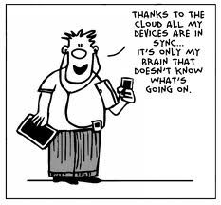

Our Solution - solves the problem
Dr. Cloud, your personal healthcare consultant
Azure Web App with personalized healthcare suggestions and alarm features
Users check their real-time health status on Azure web app
Train predictive models and Deploy models on Azure Cloud
Data Collection through wearables

Slide 9

Transformed Business model
Dr. Cloud, your personal healthcare consultant
Cost savings
Save substantial capital costs with zero in-house server storage and application requirements.
No major change in current Business model
Deploy mission critical applications that deliver significant business benefits, without any upfront costs and minimal provisioning time.

Slide 10






Techniques in Dr. Cloud
Dr. Cloud, your personal healthcare consultant
Internet of Things (IoT)
Big Data & Cloud Computing
Healthcare wearables
Remote Health and monitoring
Improve prediction accuracy
Advanced models become possible
Improve Response Speed
Reduce Operation Cost
Ensure Security
AI analytics
Mobile App
Expert predictions
Personalized healthcare tips
Expand diagnostic services
Real-time response
Easy to use
Interactive Visualization
Data Modeling
Data Integration
Adaptive Data Modeling
Intuitive and understandable
Better user experience

Slide 11
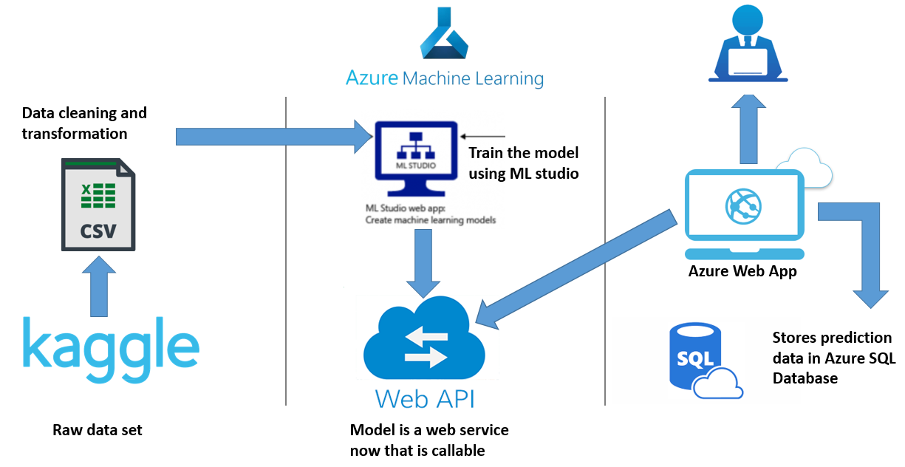

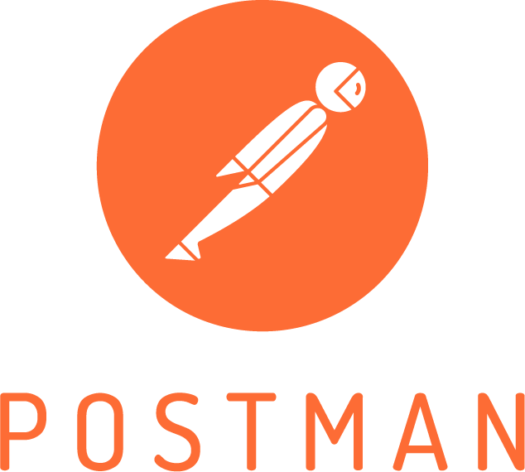
Methodology Framework
Dr. Cloud, your personal healthcare consultant

Slide 12
Data Modeling
Dr. Cloud, your personal healthcare consultant
Variable Name | Data Type | Description
ID | int | Patient ID
Gender | string | Gender of Patient
age | int | Age of Patient
hypertension | binary | 0 indicates no hypertension; 1 indicates suffering from hypertension
Heart disease | binary | 0 indicates no heart disease; 1 indicates suffering from heart disease
Ever married | string | Yes or no
Work type | string | Type of occupation (five classifications would be given for users to choose from)
Average glucose level | float | Average Glucose level measured after meal
Residence type | string | Area type of residence (Urban/Rural)
bmi | float | Body mass index
Smoking status | string | Patient’s smoking status (three types of smoking status would be given for users to choose from)

Slide 13
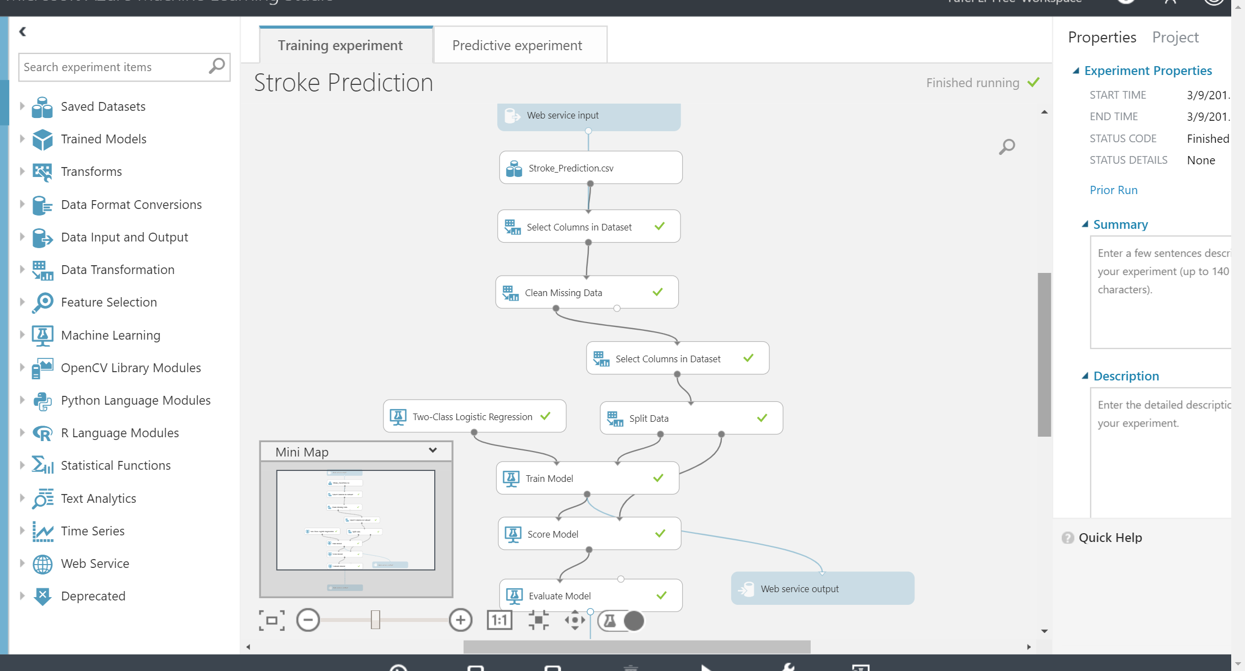
Training Experiment

Slide 14
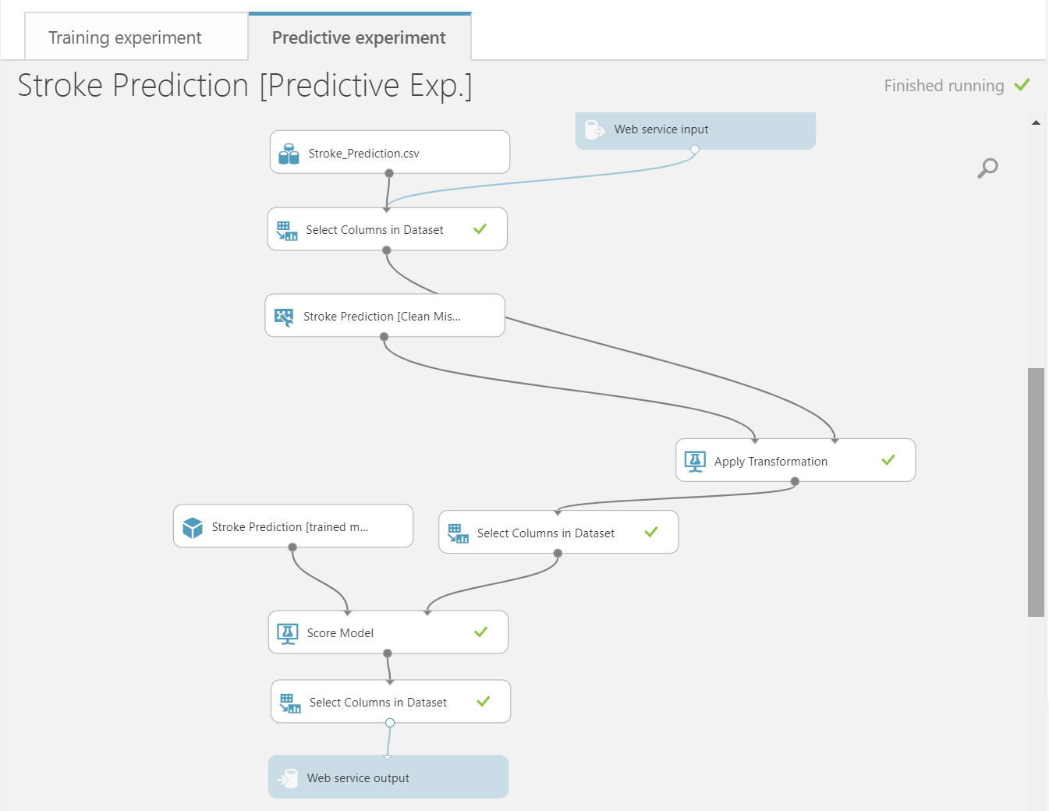
Predictive Experiment

Slide 15





Features & Functionality
Dr. Cloud, your personal healthcare consultant
Check Real-time health Status
Disease and Risk Monitor
Make storke predictions based on 10 features
Provide likelihood estimation on diseases
Physicians can login to the system and monitor the disease risk for different patients.
They can take action and contact the patients via the platform.
Automated Data Collection
Cloud-based Service
Healthcare Wearables linked to the cloud
Don’t need to spend time to make hospital reservation
Scalable
Easy to use
7 * 24 available
-

Slide 16




Limitation & Constraints
Dr. Cloud, your personal healthcare consultant
Data quality management
The dataset we used is unbalanced and biased. It only covers 10 features which is limited.
03
Algorithm is simple
We used logistic regression for this binary classification. We might try more advanced models in future.
04
Down time
Technical outages can result in unavailability of the web app which is critical for 24/7 data access for hospitals.
02
Limited features
Current model only covers 10 features, which is limited due to the nature of stroke depends on multiple factors

Slide 17
Future Work
Dr. Cloud, your personal healthcare consultant
Data Cleaning Processes
We need to preprocess the data more properly in the production environment, since patients may input different kinds of data.
03
More advanced algorithms
04
We’ll use more advanced predictive models such as deep learning and neural network.
Hybrid Cloud Strategy
We may try different cloud products and would use hybrid clouds in the future.
02
BI dashboards
Hospital IT staff are supposed to build data warehouse to collect all the data. Some features would be added later, such as BI dashboards on the app for physicians to see.

Slide 18
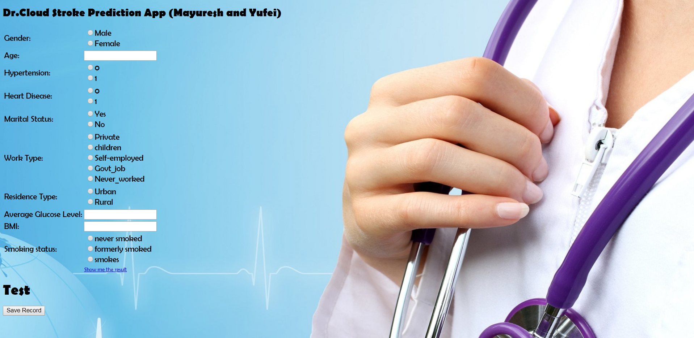
Demo Representation
Dr. Cloud, your personal healthcare consultant
Link to the Stroke Prediction Demo: http://drcloudstrokeprediction.azurewebsites.net/

Slide 19
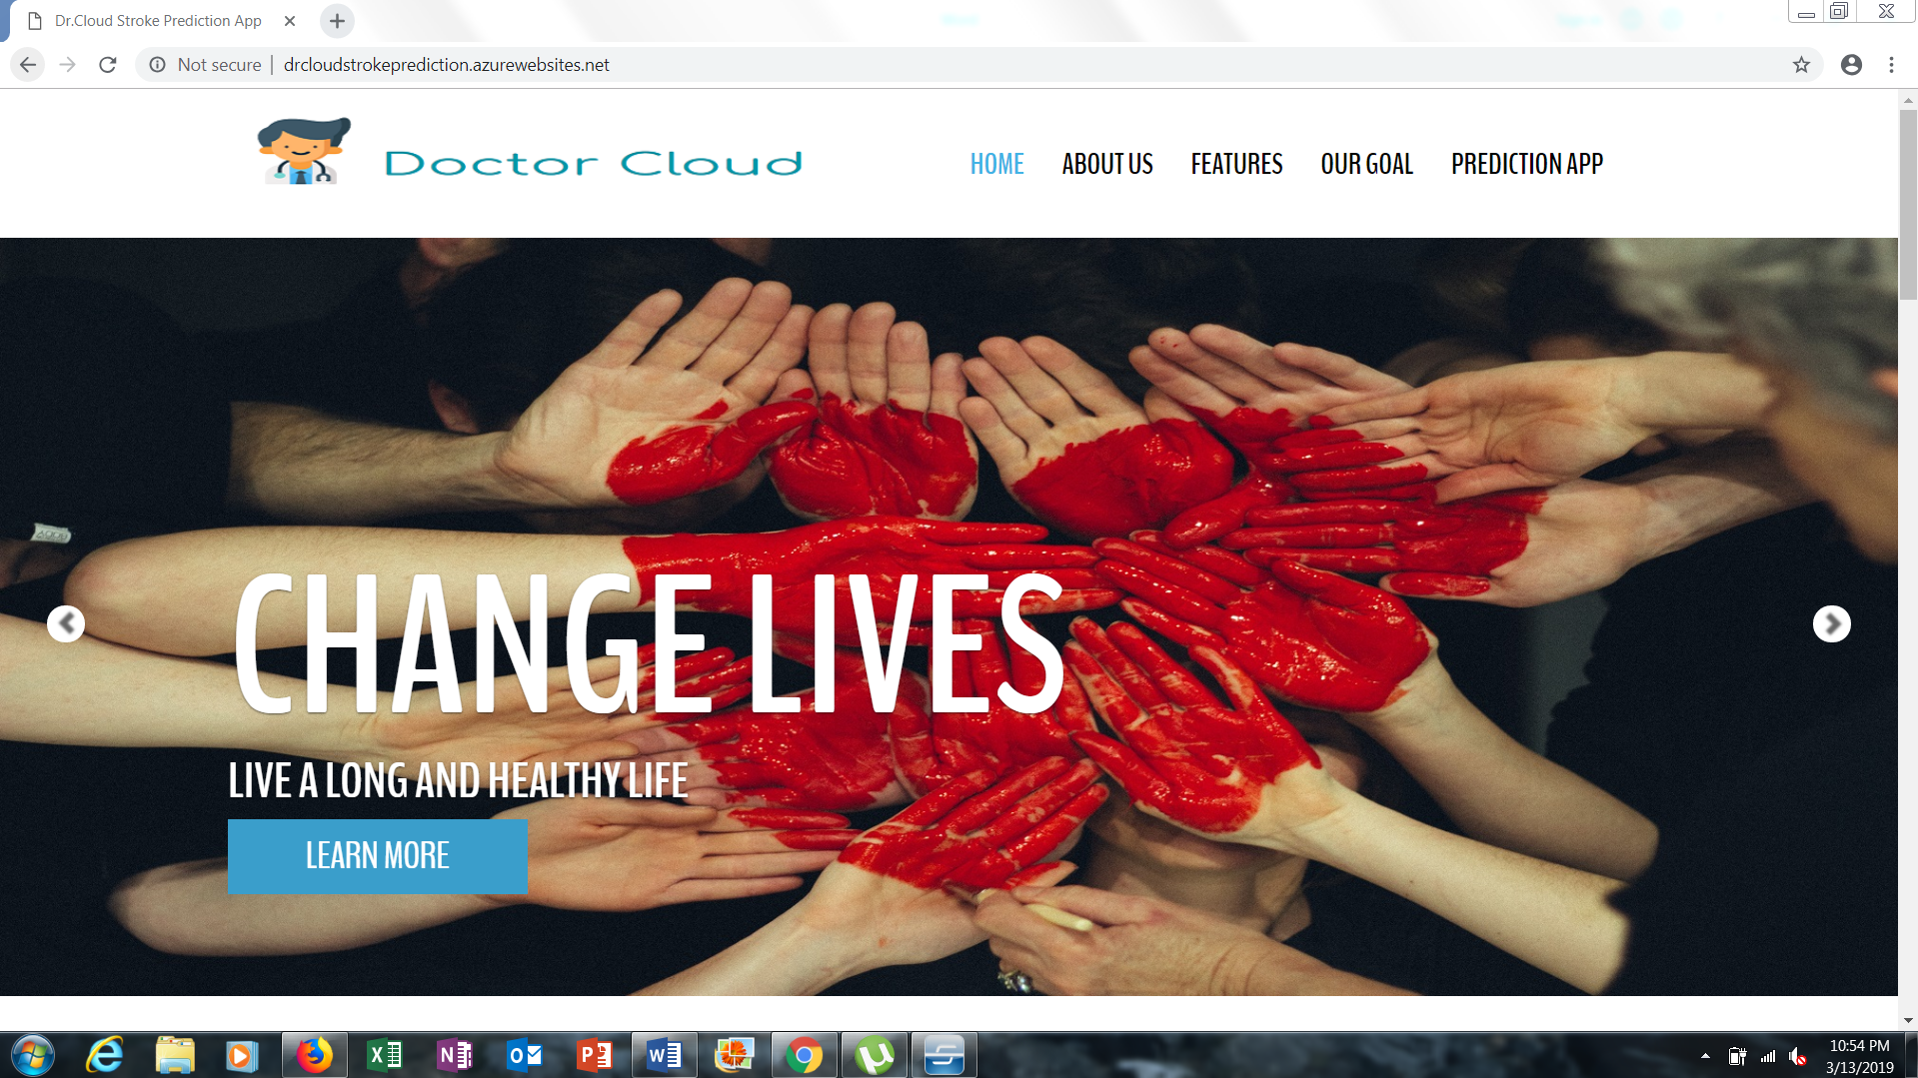
Demo Representation
Dr. Cloud, your personal healthcare consultant
Link to the Stroke Prediction Demo: http://drcloudstrokeprediction.azurewebsites.net/

Slide 20
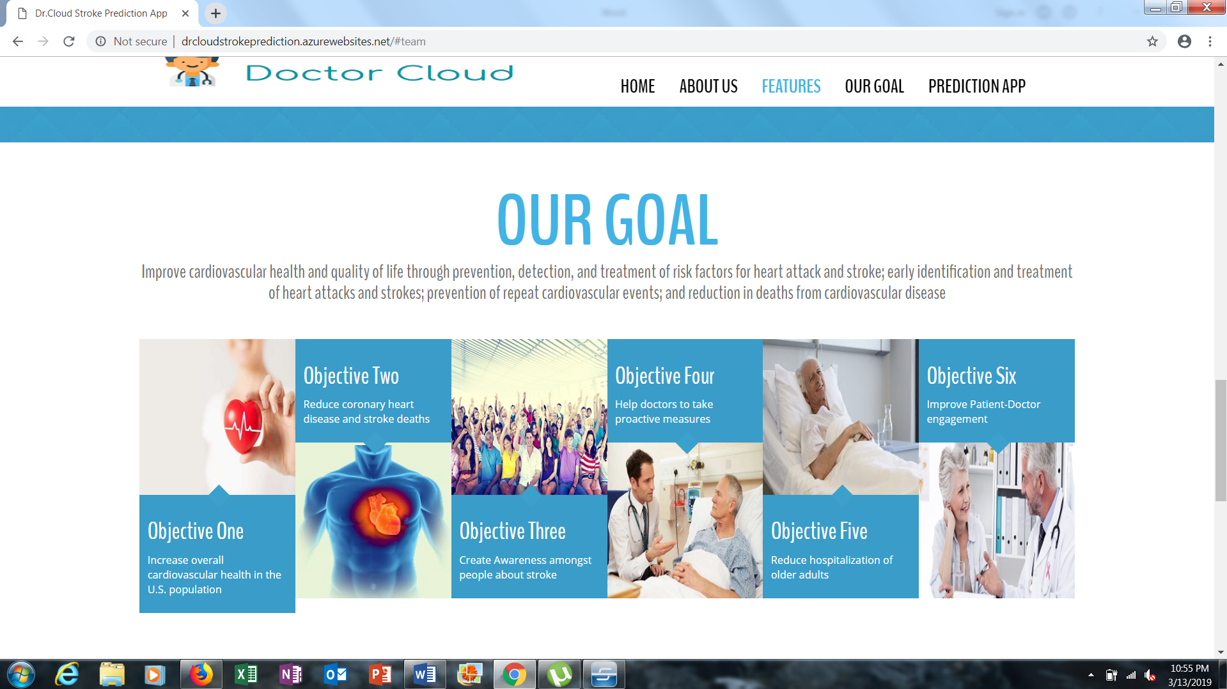
Demo Representation
Dr. Cloud, your personal healthcare consultant
Link to the Stroke Prediction Demo: http://drcloudstrokeprediction.azurewebsites.net/

Slide 21
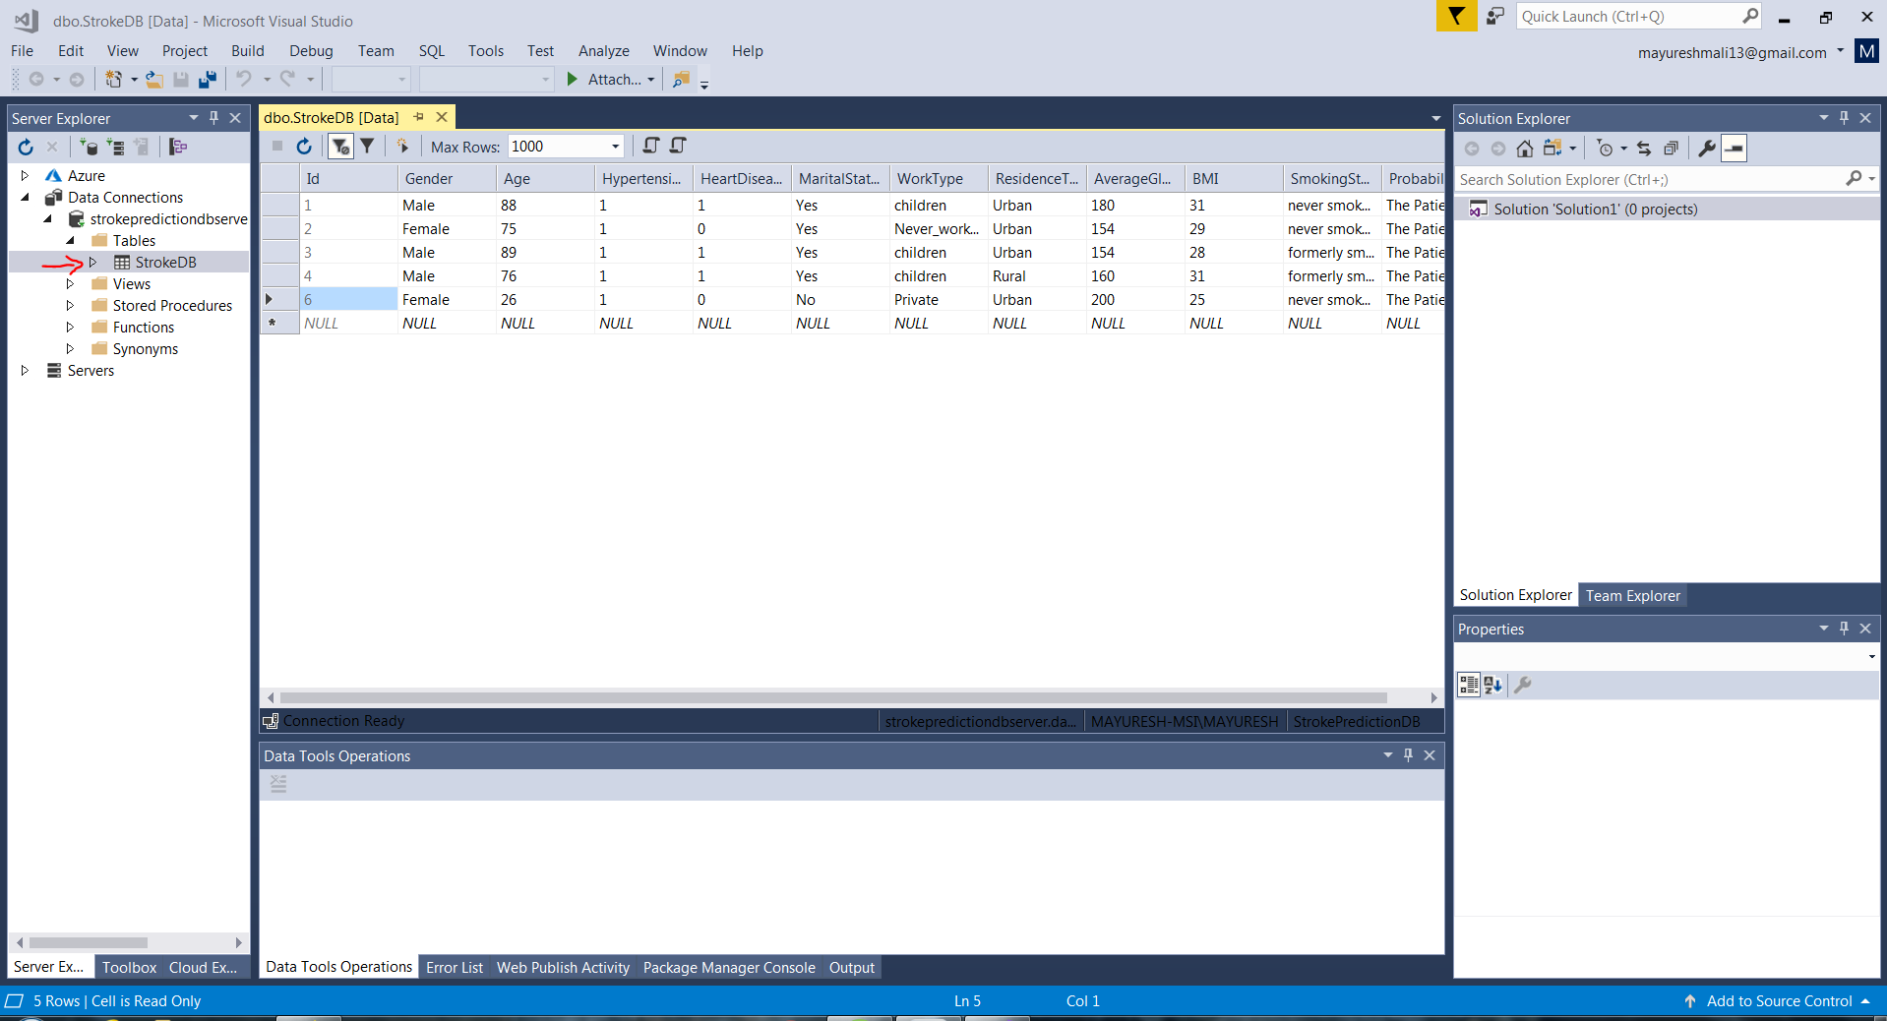
Demo Representation
Dr. Cloud, your personal healthcare consultant
Azure SQL Database live connection

Slide 22
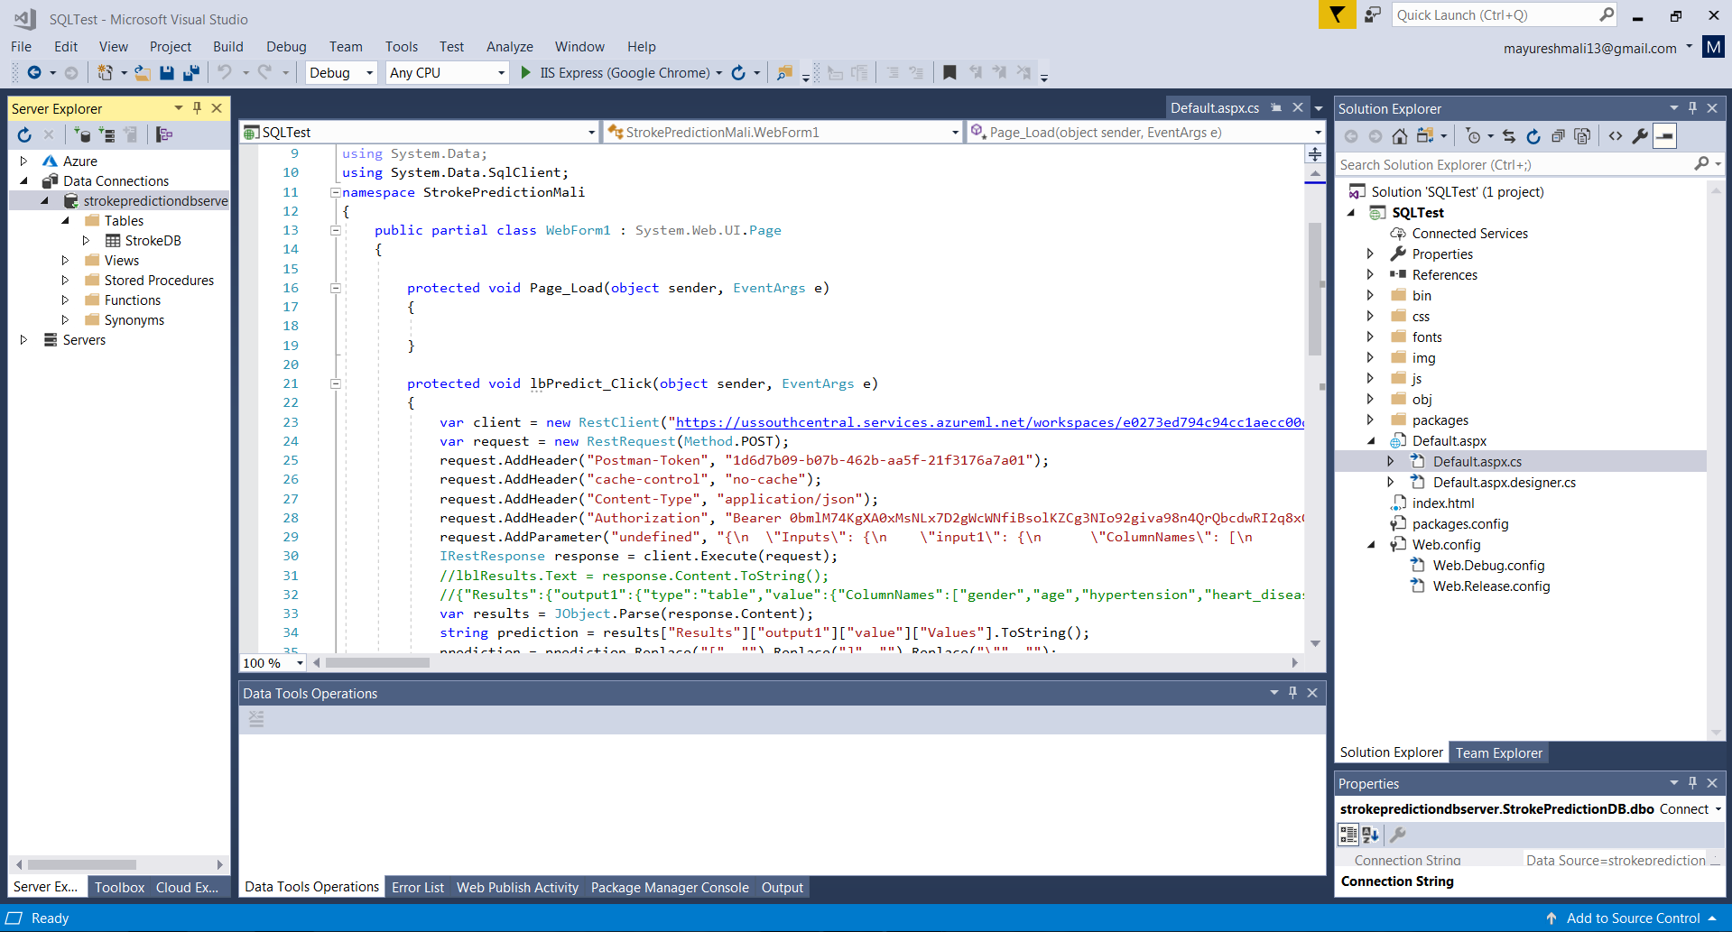
Demo Representation
Dr. Cloud, your personal healthcare consultant
Visual Studio directory for Web app code in C# and ASP.Net

Slide 23


